Slide 1
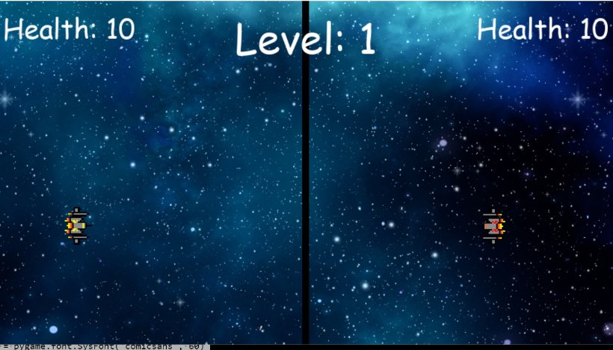


Spaceship Duel: A Thrilling Multiplayer Game by
Suleman Majeed Imad Ahmad Muhammad Abubakar

Slide 2

Game Concept:
A competitive two-player spaceship fighting game set in a visually stunning space arena. Players engage in fast-paced, strategic battles to prove their supremacy.

Slide 3
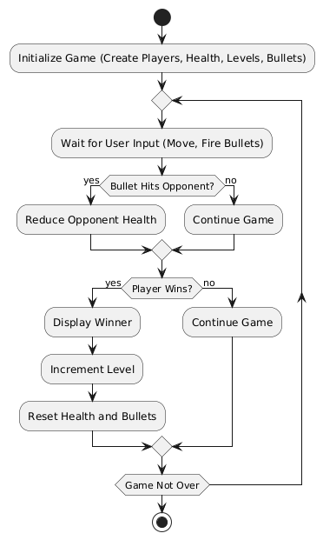
Flow chart:

Slide 4
The Art of Spaceship Design
Objectives
Outmaneuver and outshoot your opponent to deplete their health and emerge victorious across multiple levels of escalating difficulty.

Slide 5

Main Features
Two-Player Gameplay:
2. Dynamic Health System:
Yellow Spaceship: Controlled using WASD keys and Left Control to fire bullets.
Each spaceship starts with 10 health points.
Health decreases when hit by bullets. Level Progression:
Red Spaceship: Controlled using arrow keys and Right Control to fire bullets.Missiles
Each round ends when a spaceship’s health reaches zero.
Powerful but slow, with a lock-on system. They're ideal for long-range attacks.
The winner advances to the next level with a reduced health handicap for added challenge.
Winning Condition:
A player wins the round when their opponent’s health reaches zero.
Victory is announced with a celebratory message and visual effects.

Slide 6
Introduction to OOP in the Game
Object-Oriented Programming (OOP) is used to structure and organize the code efficiently.
This game uses OOP principles such as Classes, Objects, Inheritance, and Encapsulation.
The game involves spaceships battling in different levels.

Slide 7
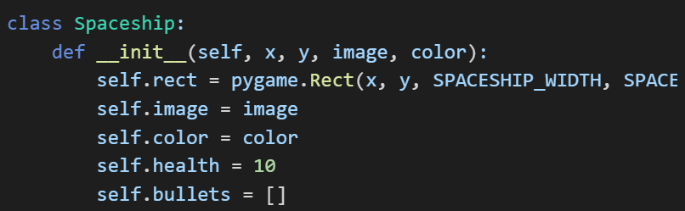
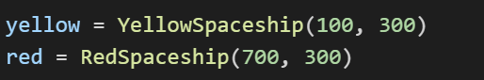
Classes and Objects
A class is a blueprint for creating objects.
An object is an instance of a class.
Objects created from the class:

Slide 8
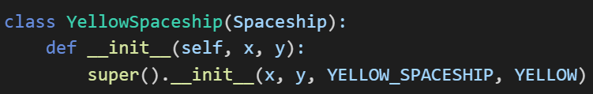
Inheritance
Inheritance allows a new class to derive properties and methods from an existing class.
The game uses single inheritance, where a subclass inherits from one parent class.
RedSpaceship and YellowSpaceship inherit from Spaceship and reuse its methods and attributes.

Slide 9
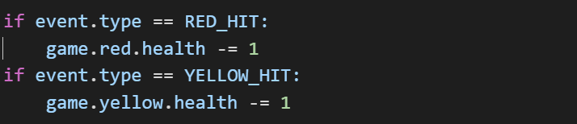
Encapsulation
Encapsulation ensures that data is hidden and only accessible through defined methods.
Example: Spaceship's health is only modified by event handling, preventing direct modification.
The health attribute is protected from unauthorized changes.

Slide 10
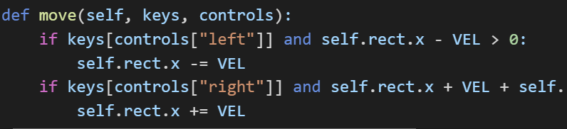
Methods in Classes
Methods define behavior for objects.
Example: The move method allows spaceship movement.

Slide 11
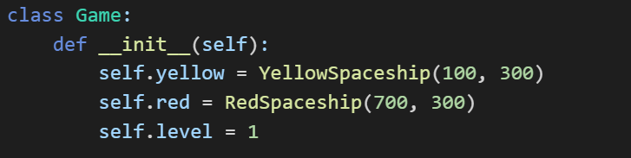
Game Class and Object Interaction
The Game class manages the entire game flow.

Slide 12
Additional OOP Concepts Used
Polymorphism: Both YellowSpaceship and RedSpaceship inherit from Spaceship, but they behave differently based on their specific attributes.
Abstraction: The Spaceship class abstracts the common properties of spaceships so specific spaceship types can focus on their unique attributes.

Slide 13

The Power of Pygame
1
Open Source
2
User-Friendly
Pygame is free to use and modify, making it accessible for both beginners and experienced developers.
It's written in Python, a simple and beginner-friendly language. The library is well-documented and has a vibrant community.
3
Powerful
Pygame allows you to create 2D games with graphics, sounds, and user input with ease.

Slide 14
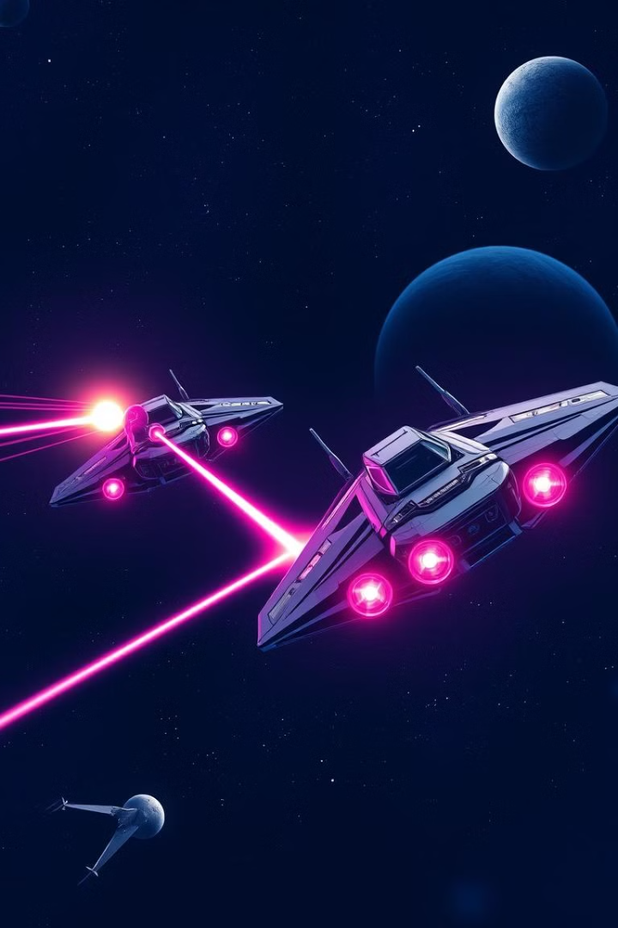



Visual Highlights
Central Border: Divides the play area for balance.
Health Indicators: Display each spaceship’s current health.
Level Counter: Tracks progression through the game.

Slide 15




Adding a Multiplayer Twist
Gameplay:
Players control their spaceships, fire bullets, and dodge attacks.
Synchronization
Ensure all players see the same game state by synchronizing the gameplay.
Game Logic
Adapt your game logic to support multiple players, including collisions and damage.

Slide 16




Polishing Your Game
Dynamic Health System:
1
Each spaceship starts with 10 health points.
Health decreases when hit by bullets.
Bullet Mechanics
2
Each spaceship can fire up to 3 bullets at a time.
Bullets travel horizontally toward the opponent.
Level Design
3
Each round ends when a spaceship’s health reaches zero.
The winner advances to the next level with a reduced health handicap for added challenge.
Winning Condition:
4
A player wins the round when their opponent’s health reaches zero.
Victory is announced with a celebratory message and visual effects.

Slide 17

Blast Off into the Future
Spaceship Duel is a fast-paced, exciting multiplayer game that combines reflexes, strategy, and skill. With its engaging level system and immersive visuals, it provides endless entertainment for players of all ages. Are you ready to take control and dominate the galaxy?

Slide 18
Conclusion
OOP principles make the code modular, reusable, and easier to maintain.
Classes and Objects allow structured code organization.
Single Inheritance is used to extend the Spaceship class.
Encapsulation ensures data protection.
The Game class manages the entire gameplay using objects and their methods.

